Slide 1
More SQL
SQL tutorial: http://www.w3schools.com/sql/default.asp

Slide 2
Outline
Structured Query Language (SQL)
PHP and MySQL (see manual http://php.net/manual/en/book.mysqli.php)
How to connect to MySQL via PHP
Example:
Create a Database for IMDB data
Write PHP to connect to DB, query tables, display results
Write PHP to create a drop-down menu using data from database
Write PHP to issue queries on DB using menu selection

Slide 3
Structured Query Language (SQL)
SQL was proposed in 1970s by D. Chamberlin and R. Boyce
Data definition language (DDL)
Define the schema (create, change, delete relations)
Specify constrains, user permissions
Ex. CREATE TABLE Students (sid string, name string, …. );
Data modification language (DML)
Find data that matches criteria
Add, remove, update data
The DBMS is responsible for efficient evaluation
Ex. SELECT * FROM Students were name = “Mary”;

Slide 4
SQL: Creating Relations
Create Students relation:
Create Enrolled relation:
CREATE TABLE Students (
sid CHAR(20),
name CHAR(20),
login CHAR(20),
SSN CHAR(12),
gpa FLOAT
);
CREATE TABLE Enrolled (
sid CHAR(20),
cid CHAR(20),
grade FLOAT
);
Insert a single tuple
Delete tuples that satisfy condition
INSERT INTO Students (sid, name, login, SSN, gpa) VALUES (21, “Mary”, “marys”, “000-00-0000”, 3.4);
DELETE FROM Students S
WHERE S.name = “Mary”;

Slide 5
Integrity Constraints
Students
Enrollment
SID | Name | Login | SSN | GPA
45 | Mary | maryS | 000-000-000 | 3.4
67 | John | johnT | 000-000-000 | 3.5
78 | Erin | erinK | 000-000-000 | 3.7
SID | CID | Grade
45 | Mary | 100
67 | John | 99
78 | Erin | 89
Primary Key
Foreign Key
The Primary Key is a field that uniquely identifies a tuple (a super key is a set of fields)
A Foreign Key is a key in one relation refers to a primary key of another relation.

Slide 6
SQL: Creating Relations
Create Students relation:
Create Enrolled relation:
CREATE TABLE Students (
sid CHAR(20),
name CHAR(20),
login CHAR(20),
SSN CHAR(12),
gpa FLOAT
PRIMARY KEY(sid),
UNIQUE (SSN)
);
CREATE TABLE Enrolled (
sid CHAR(20),
cid CHAR(20),
grade FLOAT,
PRIMARY KEY (sid,cid),
FOREIGN KEY (sid)
);

Slide 7
Basic SQL Query
Remove duplicate tuples
Selecting fields of interest
SELECT [DISTINCT] target-list
FROM relation-list
WHERE qualification
ORDER BY fields(s) [ASC|DESC]
LIMIT num_rows
Set of relations
Discard tuples that fail condition
Order tuples in result
Limit number of tuples in the result
What actually happens when you write a SQL query?? Well, the query is optimized before execution… but we still should try to write efficient queries.

Slide 8
Example
sname
rating
bid
sid
day
sid
age
reserves
Sailors
Reserves
Is reserved
Boats
bid
bname
color

Slide 9
Visualizing Query Evaluation
SELECT sname
FROM Sailors, Reserves
WHERE Sailors.sid = Reserves.sid AND bid=103
Sailors
Reserves
sid | name | rating | age
sid | bid | day
Join condition: are these the same sid?
Is this bid 103 ??

Slide 10
Example Relation Instances
Sailors
Boats
Reserves
Sid | name | rating | age
22 | Dustin | 7 | 45
31 | Lubber | 8 | 55.5
95 | Bob | 3 | 63.5
bid | bname | color
101 | SinkRise | blue
102 | SinkRise | red
103 | Clipper | green
104 | Marine | red
sid | bid | day
22 | 101 | 10/10/96
95 | 103 | 11/12/96

Slide 11
Range Variables
We can associate “range variables” with the relations in the FROM clause
Saves writing, makes queries easier to understand
Like an alias
Needed when ambiguity could arise
For example, if the same relation used multiple times in the same FROM clause (called self-join)
SELECT sname
FROM Sailors S, Reserves R
WHERE S.sid = R.sid;
QUERY: Find all the Sailors who have reserved at least 1 boat

Slide 12
Range Variables
Example where range variables are required (self-join example)
SELECT S1.sname, S1.age, S2.name, S2.age
FROM Sailors S1, Sailors S2
WHERE S1.age = S2.age AND
S1.rating = S2.rating;
Since we are doing a self-join, we need to use the “Range Variables”

Slide 13
NULL Values
Field values in a tuple are sometimes missing
Unknown (e.g. a rating or grade has not been assigned)
Inapplicable (e.g. no spouse’s name)
SQL provides a special value null for such situations.
The presence of null complicates things
Is “rating > 8” true or false when rating is null?
It is not possible to test for NULL values with comparison operators, such as =, <, or <>.
Proper way: check if a value is not null using IS NULL
SELECT LastName, FirstName, Address
FROM Persons WHERE Address IS NULL
Lastname | FirstName | Address
Smith | Dustin
Hansen | Lubber
Patterson | Bob

Slide 14
Null Values – 3 Valued Logic
We need a 3-valued logic:
Values : True, False, and Unknown
AND | T | F | NULL
T | T | F | Unknown
F | F | F | F
NULL | Unknown | F | Unknown
OR | T | F | NULL
T | T | T | T
F | T | F | Unknown
NULL | T | Unknown | Unknown

Slide 15
Expressions
Can use arithmetic expressions in SELECT clause (plus other calculations we’ll discuss later)
Use AS to provide column names
Can also have expressions in WHERE clause:
SELECT S.sname, S.rating %2 AS evenOddRating
FROM Sailors S
WHERE S.age >= 18;
SELECT S1.sname as name1, S2.sname as name2
FROM Sailors S1, Sailors S2
WHERE 2*S1.rating > S2.rating;

Slide 16
QUERY: Find sids of sailors who have reserved a red or green boat
SELECT DISTINCT R.sid
FROM Boats B, Reserves R
WHERE R.bid = B.bid AND
B.color=‘red’ AND B.color=‘green’;
Is this correct???

Slide 17
QUERY: Find sids of sailors who have reserved a red or green boat
SELECT DISTINCT R.sid
FROM Boats B, Reserves R
WHERE R.bid = B.bid AND
(B.color=‘red’ OR B.color=‘green’);
UNION: allows to compute the union of two union-compatible sets of tuples
SELECT DISTINCT R.sid
FROM Boats B, Reserves R
WHERE R.bid = B.bid AND B.color=‘red’
UNION
SELECT DISTINCT R.sid
FROM Boats B, Reserves R
WHERE R.bid = B.bid AND B.color=‘green’;

Slide 18
QUERY: Find sids of sailors who have reserved a red and a green boat.
INTERSECT:
Can be used to compute the intersection of any two union-compatible sets of tuples
SELECT R.sid
FROM Boats B, Reserves R
WHERE R.bid = B.bid AND B.color=‘red’
INTERSECT
SELECT R.sid
FROM Boats B, Reserves R
WHERE R.bid = B.bid AND B.color=‘green’;
INTERSECT will find the overlapping tuples between the first and second queries.

Slide 19
Nested Queries
Can use SQL queries to aid the evaluation of another SQL query
WHERE clause can itself contain an SQL query~
Actually, so can FROM and HAVING clauses.
SELECT S.sid
FROM Sailors S
WHERE S.rating > (SELECT AVG(rating)
FROM Sailors);
To understand semantics of nested queries, think of a nested loops evaluation: For each Sailors tuple, check the qualification by computing the subquery.

Slide 20
Nested Queries
Subqueries can also be relations with many tuples
QUERY: Find Sailors who have not reserved boat #103
SELECT S.sname
FROM Sailors S
WHERE S.sid NOT IN (
SELECT R.sid
FROM Reserves R
WHERE R.bid = 103
);

Slide 21
Nested Queries with Correlation
QUERY: Find names of sailors who’ve reserved boat #103
EXISTS is another set comparison operator, like IN.
SELECT S.sname
FROM Sailors S
WHERE EXISTS (
SELECT *
FROM Reserves R
WHERE R.bid = 103 AND S.sid=R.sid
);

Slide 22
More on Set-Comparison Operators
We’ve already seen IN, EXISTS and UNIQUE.
Can also use NOT IN, NOT EXISTS and NOT UNIQUE.
Also available: op ANY, op ALL, op IN
QUERY: Find sailors whose rating is greater than that of some sailor called Horatio
SELECT *
FROM Sailors S
WHERE S.rating > ANY (
SELECT S2.rating FROM Sailors S2
WHERE S2.sname=‘Horatio’)

Slide 23
Rewriting INTERSECT Queries Using IN
QUERY: Find sid’s of sailors who’ve reserved both a red and a green boat
Similarly, EXCEPT queries can be re-written using NOT IN.
But why???
INTERSECT is not supported by all databases
SELECT S.sid
FROM Sailors S, Boats B, Reserves R
WHERE S.sid=R.sid AND R.bid=B.bid AND B.color=‘red’
AND S.sid IN (
SELECT S2.sid
FROM Sailors S2, Boats B2, Reserves R2 WHERE S2.sid=R2.sid AND R2.bid=B2.bid AND B2.color=‘green’)

Slide 24
Aggregate Operators
SELECT COUNT (*)
FROM Sailors S
COUNT (*)
COUNT ( [DISTINCT] A)
SUM ( [DISTINCT] A)
AVG ( [DISTINCT] A)
MAX (A)
MIN (A)
SELECT AVG (S.age)
FROM Sailors S
WHERE S.rating=10
SELECT S.sname
FROM Sailors S
WHERE S.rating = ( SELECT MAX(S2.rating)
FROM Sailors S2)
SELECT AVG ( DISTINCT S.age)
FROM Sailors S
WHERE S.rating=10
SELECT COUNT (DISTINCT S.rating)
FROM Sailors S
WHERE S.sname=‘Bob’

Slide 25
QUERY: Find name and age of the oldest sailor.
Does the above query work???
SELECT S.sname, MAX (S.age)
FROM Sailors S
SELECT S.sname, S.age
FROM Sailors S
WHERE S.age = (
SELECT MAX (S2.age)
FROM Sailors S2 )

Slide 26
GROUP BY and HAVING
SELECT [DISTINCT] target-list
FROM relation-list
WHERE qualification
GROUP BY grouping-list
HAVING group-qualification
The target-list contains
(i) attribute names
(ii) terms with aggregate operations (e.g., MIN (S.age)).
The attribute list (i) must be a subset of grouping-list.
Intuitively, each answer tuple corresponds to a group, and these attributes must have a single value per group. (A group is a set of tuples that have the same value for all attributes in grouping-list.)

Slide 27
Evaluations of GROUP BY
The cross-product of relation-list is computed, tuples that fail qualification are discarded, `unnecessary’ fields are deleted, and the remaining tuples are partitioned into groups by the value of attributes in grouping-list.
The group-qualification is then applied to eliminate some groups.
Expressions in group-qualification must have a single value per group! In effect, an attribute in group-qualification that is not an argument of an aggregate op also appears in grouping-list. (SQL does not exploit primary key semantics here!)
One answer tuple is generated per qualifying group.

Slide 28
GROUP BY and HAVING
Use the HAVING clause with the GROUP BY clause to restrict which group M rows are returned in the result set
SELECT [DISTINCT] target list
FROM relation list
WHERE qualification
GROUP BY grouping-list
HAVING group-qualification

Slide 29
QUERY: Find the age of the youngest sailor with age 18, for each rating with at least 2 such sailors
Sailors
SELECT S.rating, MIN (S.age)
FROM Sailors S
WHERE S.age >= 18
GROUP BY S.rating
HAVING COUNT (*) > 1
sid | name | rating | age
22 | Dustin | 7 | 45
31 | Lubber | 8 | 55.5
64 | Rusty | 3 | 18
45 | Chris | 5 | 20
37 | Brian | 4 | 17
95 | Bob | 3 | 63.5
rating | age
7 | 45
8 | 55.5
3 | 18
5 | 20
4 | 17
3 | 63.5
rating | age
7 | 45
8 | 55.5
3 | 18
5 | 20
3 | 63.5
Only S.rating and S.age are mentioned in the SELECT, GROUP BY or HAVING clauses; other attributes `unnecessary’.
2nd column of result is unnamed. (Use AS to name it.)
rating | age
3 | 18
3 | 63.5
rating
3 | 18

Slide 30
Types of JOINs
SELECT (column_list)
FROM table_name1
[ INNER | NATRUAL | {LEFT | RIGHT | FULL} OUTER ] JOIN
ON qualification_list
[WHERE … ]
Choices:
INNER JOIN
NATURAL JOIN
LEFT OUTER JOIN
RIGHT OUTER JOIN
FULL OUTER JOIN

Slide 31
Inner Join
Only the rows that match the search conditions are returned.
Returns only those sailors who have reserved boats
SELECT S.sid , S.sname, R.bid
FROM Sailors S
INNER JOIN Reserves R
ON S.sid = R.sid;
Same as
SELECT S.sid , S.sname, R.bid
FROM Sailors S, Reserves R
WHERE S.sid = R.sid;

Slide 32
Left Outer Join
Left Outer Join returns all matched rows, and also all unmatched rows from the table on the left of the join clause.
Uses NULLs in fields of non-matching tuples
Returns all sailors & information on whether thy have reserved boats.
SELECT S.sid , S.sname, R.bid
FROM Sailors S
LEFT OUTER JOIN Reserves R
ON S.sid = R.sid;

Slide 33
Left Outer Join Example
Sailors
Reserves
Sid | sname | rating | age
22 | Dustin | 7 | 45
31 | Lubber | 8 | 55.5
95 | Bob | 3 | 63.5
sid | bid | day
22 | 101 | 10/10/96
95 | 103 | 11/12/96
22 | 102 | 12/3/97
SELECT S.sid , S.sname, R.bid
FROM Sailors S
LEFT OUTER JOIN Reserves R
ON S.sid = R.sid;
Sid | sname | bid
22 | Dustin | 101
22 | Dustin | 102
31 | Lubber | NULL
95 | Bob | 103

Slide 34
Right Outer Join
Right Outer Join returns all matched rows, plus all unmatched rows from the table on the right of the join clause
Returns all boats & information on which ones are reserved.
SELECT R.sid, B.bid, B.bname
FROM Reserves R
RIGHT OUTER JOIN Boats B
ON R.bid = B.bid;

Slide 35
Right Outer Join Example
Sailors
Reserves
Sid | bid | day
22 | 101 | 10/10/96
31 | 103 | 11/12/96
95 | 102 | 12/3/97
bid | bname | color
101 | Interlake | blue
102 | Interlake | red
103 | Clipper | green
104 | Marine | red
SELECT R.sid, B.bid, B.bname
FROM Reserves R
RIGHT OUTER JOIN Boats B
ON R.bid = B.bid;
Sid | bid | bname
22 | 101 | Interlake
22 | 102 | Interlake
95 | 103 | Clipper
NULL | 104 | Marine

Slide 36
Full Outer Join
Full Outer Join returns all (matched and unmatched) rows from the tables on both sides of the join clause
SELECT S.sid , B.bid, B.bname
FROM Sailors S
FULL OUTER JOIN Boats B
ON S.sname= B.bname;

Slide 37
Full Outer Join Example
Sid | sname | rating | age
22 | Dustin | 7 | 45.0
31 | Lubber | 8 | 55.5
95 | Bob | 3 | 63.5
bid | bname | color
101 | Interlake | blue
105 | Lubber | purple
SELECT S.sid, B.bid, B.bname
FROM Sailors S
FULL OUTER JOIN Boats B
ON S.sname = B.bname;
Sid | sname | bid | bname
22 | Dustin | NULL | NULL
31 | Lubber | 105 | Lubber
95 | Bob | NULL | NULL
NULL | NULL | 101 | Interlake

Slide 38
MySQL / PHP
The MySQL server is a separate sever hosting your database.
The backend (PHP) server will contact the MySQL server to :
Create tables
Issue queries
Insert rows
How do the two communicate?
PHP applications sends messages to the MySQL server using data access layer (i.e. API) :
PDO – PHP Data Objects extension
MYSQLI – MySQL improved extension

Slide 39
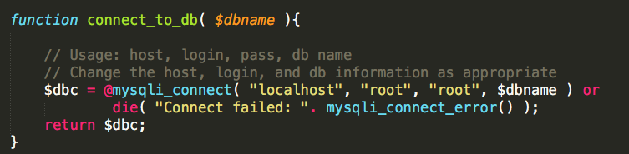
MySQL Connection
1st step is to open a new connection to the MySQL server
OOP Style usage
$db_connection = new mysqli( 'host’ , 'username', 'password’ , 'dbname’ );
Procedural Style usage
$db_connection = mysqli_connect( 'host’ , 'username’ , 'password’ , 'dbname’ );

Slide 40
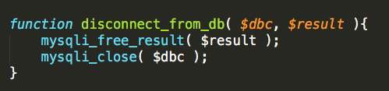
Disconnecting from DB
Last step is to close any connections to the MySQL server
mysqli_free_result ( $result ) - deallocates any memory used by the current connection to store results, etc.
mysqli_close( $db_connection ) - closes the current connection

Slide 41
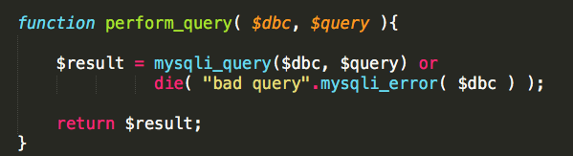
Issuing a query
To issue a query, create the query string and invoke the following function:
$result = mysqli_query ( $db_connection , $query_string)
Returns False on failure; on success of SELECT, SHOW, DESCRIBE or EXPLAIN queries, returns a mysqli_result object.

Slide 42
Viewing the query results
To check the number of rows returned by the result:
$num = mysqli_num_rows( $result )
Returns an integer representing number of rows in the result object
To fetch a row from the result object:
$row = mysqli_fetch_array( $result , MYSQLI_ASSOC )
Optional
param
MYSQLI_ASSOC
MYSQLI_NUM
$row = mysqli_fetch_array( $result , MYSQLI_NUM ) // fetches each row of the result like this:
array( 0 => ”mary", 1 => "smith" );
$row = mysqli_fetch_array( $result , MYSQLI_ASSOC ) // fetches an array like this:
array( “firstname" => ”mary", ”lastname" => ”smith" );

Slide 43
Viewing the query results (Cont.)
Continue to retrieve row
Object while not NULL
$result = perform_query( $dbc , $query );
echo "Num Results:" . mysqli_num_rows( $result );
while ( $row = mysqli_fetch_array( $result , MYSQLI_ASSOC ) ) {
$title = $row['title'];
$year = $row['year'];
}

Slide 44
Example
Lets create a Database for IMDB data, loading the data from a CSV file and then utilizing PHP to query the database and display results.
Using MYSQL command line:
Create a database and the appropriate table(s)
Load CSV file into created table
Issue queries to verify everything looks good
From the PHP application:
Write PHP code to connect and query the database
Write PHP code to display query results
Example folder name: PHP_MYSQL_IMDB
Note, MySQL database by default
may prevent loading CSV files into tables for security issues.
Disable this feature my modifying your
startMysql.sh script and adding the following option parameter
--secure-file-priv=""

Slide 45
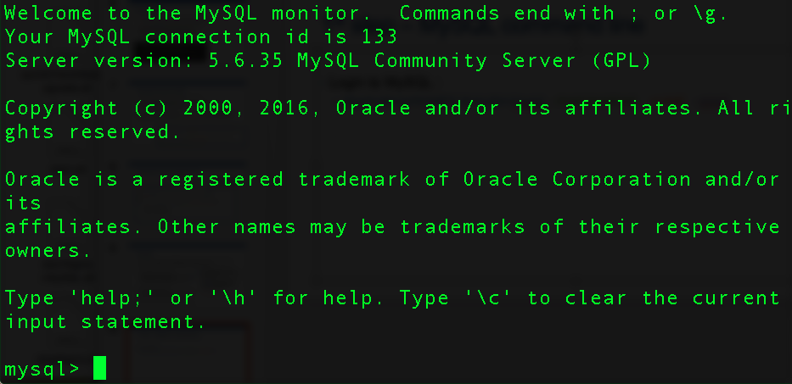
1st step – starting MySQL session
Login to MySQL :
/Applications/MAMP/Library/bin/mysql --host=localhost -u root –proot

Slide 46
2nd step – Create database
Create a imdb.sql file which will contain the sequence of commands to:
Create the database
Create the tables
Query the tables
What does the data look like??? movie.csv
Its a csv file where each row contains:
title , director , duration , gross , genres , year , imdb_score
Hence, we need to create a table with the same fields (and appropriate datatypes) before loading the data.
Once we do that, we can load the CSV file into the table using “LOAD DATA INFILE”

Slide 47
3rd step – Connect to DB using PHP
We will write higher-level functions to handle connect / disconnect to the database
We will write PHP code to query the database and display the results.
Select_record.php
Select_multiple.php
Create_select.php

